Slide 1

LDMS Darshan Connector: For Run Time Diagnosis of HPC Application I/O Performance
Sara Walton, SNL
Omar Aaziz, SNL
Ana Luisa V. Solórzano, Northeastern University
Ben Schwaller, SNL

Slide 2
Introduction & Motivation
Many efforts to identify the origin of application I/O performance variation have been performed in post-run analyses.
I/O Characterization tools (e.g. Darshan, Datadog, etc.)
Linux tools for disk I/O monitoring (e.g. iotop, dstat, etc.)
However, I/O Performance continues to show high variations on large-scale production systems. This can be caused by a variety of system related components (i.e. system usage, file system, network congestion, etc.)
Difficult to determine root cause of I/O related problems
Difficult to have a thorough understanding of throughput for system-specific behaviors and I/O performance in similar applications across a system
Limitations with existing I/O characterization tools
The I/O application data is used for post-run analysis.
Possible to get a set timeseries during an application run.
Unable to see what happens before or after this set of data.
Other collaborators (e.g. Northeastern University) have found a full set of timeseries data will benefit their studies.
Developed a tool that collects and provides runtime access to I/O event timeseries data.
Results show the success of capturing runtime I/O behavior and patterns.

Slide 3
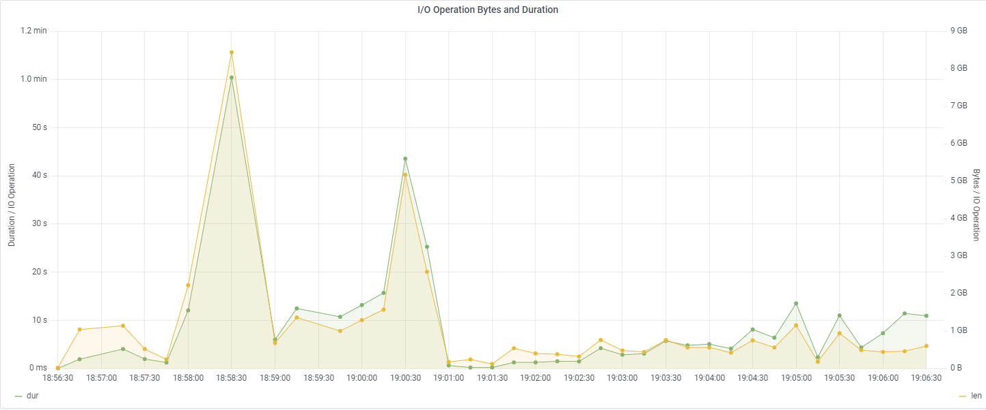
Approach
HPC System
Storage/Analysis System
Time
Application
I/O Event Data
Analysis and Visualization Infrastructure
Transport
Database

Slide 4
Approach - Continued
This tool collects runtime data via absolute timestamps. The runtime timeseries data will the allow further insights into the I/O behavior:
Identify the root cause(s) of I/O performance variability.
Detect when an I/O performance variability occurs during application runtime.
Able to quickly detect and address any operational issues.
Reveal correlations between I/O performance variability and system behavior.
Investigate any irregular or inconsistent timeseries related analyses.
Produce new and meaningful analyses and visualizations.
I/O event data will be collected, stored, analyzed and visualized with the Darshan LDMS Integration - A framework that integrates multiple tools to provide low-latency monitoring of I/O event data during runtime:
Darshan – A lightweight I/O characterization tool that transparently captures application I/O behavior from HPC applications with minimal overhead.
Generates a binary file of I/O traces post-run.
Lightweight Distributed Metric Service (LDMS) – A low-overhead production monitoring system that can run on HPC machines.
Capability to collect, transport, aggregate and store timeseries data during runtime.
An Analysis and Visualization Infrastructure for LDMS
Demonstrates further insights into I/O behavior through analysis modules and a web interface.
Notes:
Integration does not take up host memory so we can collect all timeseries data

Slide 5
Integration: Darshan
Darshan (lightweight I/O characterization tool) data is used to tune I/O behavior of HPC applications for increased scientific productivity or to gain insight into trends in large-scale computing systems.
Provides detailed statistics about file accesses from MPI and non-MPI applications with the following modules:
POSIX, MPI-IO, STDIO, and many more.
Darshan eXtended Tracing (DXT): Provides a more detailed profiling of I/O software stacks such as kernel I/O traces and systematic analysis on the I/O behavior of applications.
Ex: Start and end time of read and write operations for MPIIO and POSIX.
Two main parts:
darshan-runtime: The instrumentation portion of the Darshan characterization tool. Intent includes the collection of I/O characterization information of MPI & non-MPI applications.
Produces a binary file containing the I/O traces.
darshan-util: A collection of tools for parsing and summarizing log files produced by Darshan instrumentation.
Darshan log files are platform-independent.
Darshan uses absolute timestamps for reporting time related I/O event data
Does not report the raw absolute timestamps due to memory limitations on host node.
Modifications were made to expose this.
This framework utilizes this tool to continuously collect I/O event data and absolute timestamp during application runtime. This data is then published and transported via LDMS.

Slide 6
Integration: LDMS
Collection and transport process for system data.
The LDMS monitoring system collects data via samplers and plugins:
Sampler: Type of daemon that collects system data.
Plugin: Determines the kind of data collected/sampled, aggregated or stored.
Provides absolute timestamp view of system conditions through multi-hop aggregation.
Intermediate aggregators (transport) and head node aggregators (storage).
Does not take up host memory when collecting timestamped data.
Darshan LDMS Integration framework leverages LDMS transport functionality for I/O data injection.
Framework utilizes an LDMS functionality consisting of a push-based method.
Requires a push-based method to reduce memory consumed and data loss on the node.
Collection
Aggregation
LDMS Transport
LDMSD
LDMSD
Sampler Plugin
Memory Region
Memory Region
Storage Plugin
Memory Region
System Metrics
Database
Push
Pull

Slide 7
Integration: LDMS Streams
Collection and transport process for event data.
The push-based method for I/O event data injection is achieved through the LDMS Streams API.
LDMS Streams API - LDMS Functionality that allows for the aggregation of event-based application data.
LDMS Streams: A publish-subscribe bus capability.
Intended for publishing and subscribing to an LDMS streams tag (e.g. Tag A) via publish API call.
Tag needs to be specified in LDMS daemons and plugins to publish and receive LDMS Streams data with matching tags.
Enhanced to support the collection of I/O event data.
I/O event data is stored to a database designed to hold large volumes of data.
Collection
Aggregation
LDMS Transport
LDMSD
LDMS Streams
LDMSD
LDMS Streams
Streams Subscriber
Storage Plugin
Streams Publisher
Tag A
Database
Tag A
Push

Slide 8
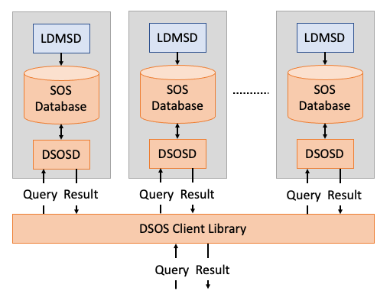
Integration: Storage Database
The Distributed Scalable Object Store (DSOS) - A storage database designed to manage large volumes of HPC data efficiently.
Allows for interaction via a command line interface.
Fast query testing and data examination.
Provides scalable data ingest and ability to query and store large volumes of data.
DSOS cluster - Consists of multiple instances of DSOS daemons, dsosd, that run on multiple storage servers on a single cluster.
Data can be queried in parallel and results returned in parallel using the DSOS client.
Queried results are sorted based on joint indices selected by user to provide different query performances
For published LDMS Streams I/O event data, the indices consist of combinations of job ID, rank and timestamp.
This framework transports I/O event data, via LDMS Transport, to the DSOS database. It is then queried with the analysis and visualization infrastructure.
Sort by joint indices example: “job_rank_time” where data will by ordered by job, rank then timestamp and search the data by specific rank within a specific job over time.
Notes:
Example: job_rank_time where data will by ordered by job, rank then timestamp and search the data by specific rank within a specific job over time.

Slide 9
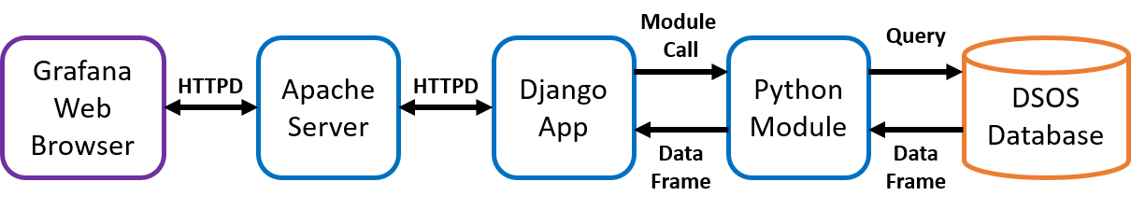
Integration: Analysis and Visualization Infrastructure
HPC Web Services – An analysis and visualization infrastructure for LDMS that integrates an open-source web application, Grafana, with a custom back-end web framework (Django).
Calls python modules for analysis and visualization of HPC data.
Used to query, analyze (Python analysis modules) and view (Grafana) sorted I/O event data in real time.
Grafana – An opensource visualization tool tailored towards time-series data from various database sources.
Provides charts, graphs, tables, etc. for viewing and analyzing queried data in real time.
Enables wide variety of visualization options for the data and allows users to save and share those visualizations to others.
Python Analysis Module – Where the queried data from DSOS to the Grafana is transformed, calculated, analyzed, etc. and then returned back to Grafana.
Allow for complex calculations, transformation and aggregations of I/O event data.
Uses a custom DSOS-Grafana API specified in a Grafana query.
Many analysis modules already exist for other types of system and application data.

Slide 10
Integration: Darshan-LDMS Connector
Q: How is data sent from Darshan to an LDMS daemon?
A: Darshan-LDMS Connector
A Darshan-LDMS Integration functionality that collects both DXT and Darshan’s original I/O tracing and optionally publishes a message in JSON format to the LDMS Streams daemon.
Current stages of connector only collect a subset of this data due to the large volume of metrics Darshan uses for I/O tracing and post-processing calculations.
Uses a single unique LDMS stream tag for the Darshan I/O data.
Uses environment variables to establish a connection to an LDMS daemon.
Little to no interference with Darshan’s original program.
Absolute timestamp is included in JSON message with the name “timestamp”.
Overview of the Darshan-LDMS connector, framework configurations and defined metrics will be covered in the following slides.

Slide 11
Integration: Darshan-LDMS Connector
Connector
Darshan
darshan-core
HAVE_LDMS
module_initialize
darshan_ldms_initialize
open**
module_read
module_write
*_ENABLE_LDMS
close
darshan_ldms_connector_send
runtime data
Darshan FILE (binary)
JSON buffer
streams store plugin
* Check if any <module>_ENABLE_LDMS env variable is set.
Check if connection to LDMS daemon succeeded.
** Gather meta data of I/O activity.
Database
Notes:
USE LASER POINTER. Focus on the LDMS Side, talk about the big picture. Don’t impact storage or memory of compute nodes

Slide 12
Integration: Configuration
Darshan – Easy to use and initialize
Only need to set the LD_PRELOAD environment variable to the full path of the Darshan shared library before executing an application.
Ex: srun -n 4 --export=LD_PRELOAD=<path-to-shared-library> <application>
LDMS – Simply set the following list of environment variables to connect to an LDMS streams daemon and published I/O event data:
*MODULE*_ENABLE_LDMS -> Set to publish *MODULE* module data to LDMS daemon.
DARSHAN_LDMS_PORT -> Port number that the LDMS daemon is listening on.
DARSHAN_LDMS_HOSTNAME -> Hostname that the LDMS daemon is running on.
DARSHAN_LDMS_XPRT -> Type of transport the LDMS daemon is listening on.
DARSHAN_LDMS_STREAM -> Name tag (identifier) of the stream.
Darshan-LDMS Integration – Easy to build and install Darshan against LDMS library:
Only need to include --with-ldms=<path-to-LDMS-install> to the configuration line.
Notes:
What is the point? Simple to configure

Slide 13
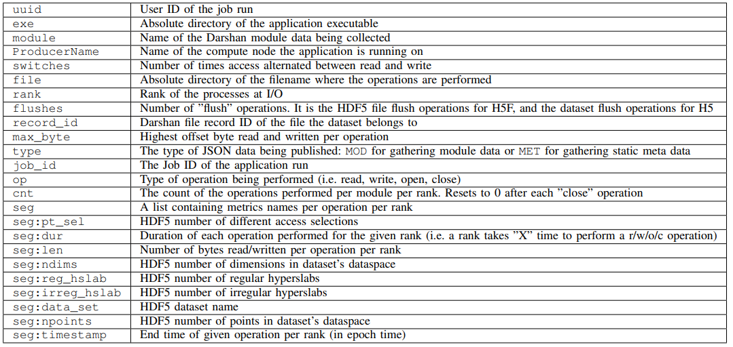
Integration: Defined Metrics
Notes:
Mention that this is in the paper. Explain why we picked these metrics

Slide 14
Integration: Summary
Data Collection
Darshan to collect timeseries I/O event data during application runtime.
Darshan-LDMS Connector to collect Darshan I/O data and publish to LDMS Streams interface.
Configuration and setup for Darshan and LDMS is quick and easy.
Various I/O event metrics are collected from Darshan’s I/O tracing.
Transport and Storage
LDMS to provide and transport live run time data feed about application I/O events.
DSOS to store and query large volumes of I/O data generated on a production HPC system.
Analysis and Visualization
HPC Web Services to analyze and present run time I/O data.
Able to demonstrate further insights into the application I/O behavior, patterns, etc.
Provides the ability to identify correlations between I/O performance and system behavior.

Slide 15
Integration: Summary
HPC System
Storage/Analysis System
Time
Application
Darshan
Darshan LDMS Connector
LDMS Streams
HPC Web Services
LDMS Transport
LDMS Streams
DSOS

Slide 16
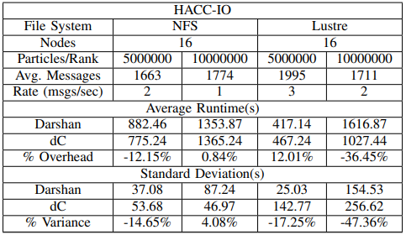
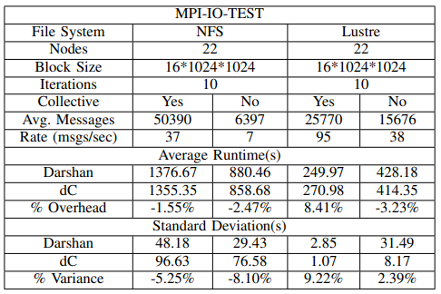
Results: LDMS Overhead
Overview:
Framework is evaluated by analyzing sampled I/O data captured from two HPC applications
MPI-IO-TEST: Darshan utility to test MPI I/O performance on HPC machines.
HACC-IO: I/O Proxy for the Hardware Accelerated Cosmology Code.
Experiments tested on Lustre and NFS file systems with various configurations.
5 runs for each configuration for a total of 40 job submissions.
Key Takeaways:
Variance statistically significant to determine the overhead calculations are inconclusive.
Most likely due to file system performance issues as tests were ran 1-2 weeks apart

Slide 17
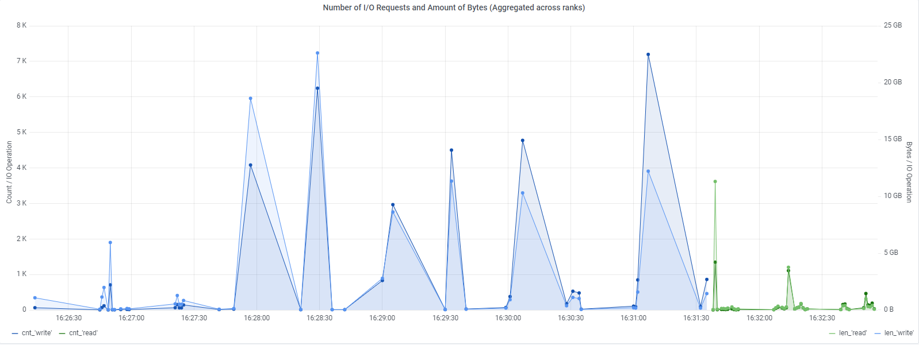
Results: Grafana Visualization
Figure above presents a Grafana visualization of MPI-IO job_id 2 writes (blue) and reads (green) operations and number of bytes read/written aggregated across all ranks.
Uses the absolute timestamp metric collected with Darshan LDMS Integration.
Grafana offers the interactive front-end view where users can easily filter though specific times and metric intervals.
Representation using absolute timestamps facilitates the correlation of I/O performance congestion with system behavior monitoring.

Slide 18
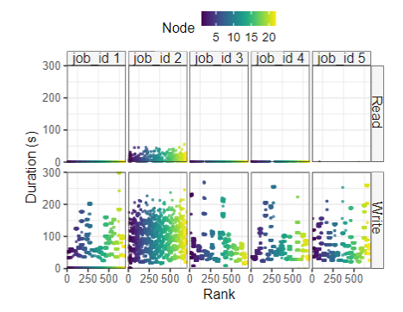
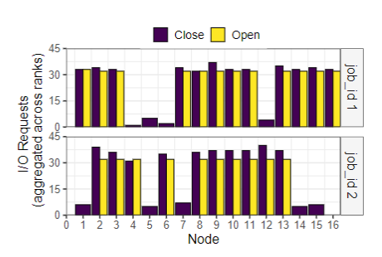
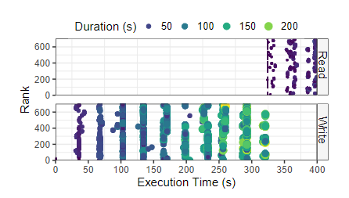
Results: Analysis
1. Post-Run Analysis of I/O event data: Number of I/O requests per node for close and open operations of 2 HACC-IO jobs. Can be produced with Darshan and framework.
2. Runtime Analyses of I/O event timeseries data:
Duration of reads and writes per rank of 5 MPI-IO jobs (job_id 1-5) without collective operations. Only produced with framework.
3. Runtime Analyses of I/O event timeseries data:
Distribution of job_id 2 to display application I/O pattern and behavior over time. Only produced with framework.
Key Takeaways
Variation is seen between two runs of the same experiment in the far left (1).
Possible data loss from connector and is currently under investigation.
Darshan LDMS Integration makes is possible to create the meaningful analyses and visualizations (2 and 3).
Ability to see when an operation occurs, it’s duration and variability between runs.
Allows for further insights into I/O behavior and patterns during application execution.
Experiment on the far left shows the aggregate I/O behavior which can be created with Darshan alone (e.g. post run data).
Unable to analyze when an operation occurs and duration of each operation.
Prevents further insights into I/O behavior and patterns during application execution.

Slide 19
Related Work
PASSION Runtime Library for parallel I/O proposed by Syracuse University
Optimizes I/O intensive applications through Data Prefetching and Data Sieving.
IOPin: Runtime Profiling of Parallel I/O in HPC Systems
Proposes dynamic instrumentation to show the interactions from a parallel I/O application to the file system.
Design and Implementation of a Parallel I/O Runtime System for Irregular Applications
Proposes two different collective I/O techniques for improving I/O performance.
Other Open-Source Tools
iostat – Linux command that collects and reports I/O device statistics and loads between physical disks.
ioprof – Provides insights into I/O workloads.
How Is Darshan LDMS Integration Different?
Provides runtime timeseries data of I/O events
Leverages and enhances existing applications and tools
Integrates LDMS’s timestamped data collection and storage capabilities with Darshan.
Integrates python analysis modules and open-source web application for the analyses and visualizations.
Provides extensive I/O tracing (i.e. statistics of individual I/O operations) of applications.
Implemented a database to allow for efficient queries of large volumes of data.

Slide 20
Conclusions & Future Work
Overview:
This framework utilized Darshan’s I/O event data tracing and LDMS Streams interface to capture timeseries data of I/O events during application runtime.
Provided the capability to query, analyze and view the timeseries data via DSOS and HPC web services.
Demonstrated further insights into application I/O behaviors and patterns with visualizations and analyses.
Completed work:
Ability to enable or disable the LDMS Streams functionality for specific Darshan modules.
Establish a simple connection from Darshan to LDMS via the LDMS Streams API to publish runtime data generated by Darshan.
Completed multiple I/O application runs with the Darshan LDMS Integration and successfully collected runtime timeseries data of the I/O events.
Full timeseries data can be collected throughout entire application execution.
Future work:
Characterize the Darshan LDMS connector overhead with a variety of I/O intensive applications.
Further validate any data loss by comparing Darshan’s output log files to the timeseries data.
Utilize this framework to investigate impact of file system performance on I/O intensive applications.
Incorporate existing analyses and create new analyses to present in Grafana.

Slide 21
QUESTIONS?

Slide 22
Additional Information
Current Darshan changes can be found in the following github repository: darshanConnector_1c1a31c
Modified Files: darshan-runtime/lib/configure.ac darshan-runtime/lib/darshan-dxt.c, darshan-runtime/lib/darshan-mpiio.c, darshan-runtime/lib/darshan-posix.c, darshan-runtime/lib/Makefile.am, darshan-runtime/darshan.h.
darshan-posix.c (line 239) & darshan-mpiio.c (line 237) are modified in order add “filename” to json message.
Additional Files: check_ldms.m4 in <top>/maint/config/
Additional information about the LDMS and Darshan Build and Install can be found at the github wiki page: Darshan-&-LDMS-Install

Slide 23
Motivation
NERSC has completed several studies involving the I/O performance variance of multiple applications and reported any implications they have come across. Examples of the more significant analysis results include:
The highest I/O performance variations on clusters occur during the weekend days.
It is assumed that this could be from I/O intensive application runs during the weekends.
The I/O timeseries data generated by LDMS will provide NERSC researchers with new data they can utilize to further their research.
Different applications experience high and low performance variations at separate and disjoint time periods.
These times periods are shared across different applications and clusters. It is suggested that a simple I/O monitoring data collection from Darshan will be useful in identifying these time periods.
The Darshan-LDMS Integration will be able to provide the runtime I/O monitoring data collection which will help them in identifying these time periods.
The timeseries data generated with the integration of LDMS will allow NERSC (along with other collaborators) to understand:
How the I/O pattern within a run affects the I/O performance of read and write.
An application that has nodes writing data at disjoint times might have less I/O performance variation than one that has all nodes writing data at the same time.
Why read and write I/O performance patterns are different and independent of each other
Read and write may exhibit different behavior during the run, which affects the performance of each in unique ways.
How the time of day affects the I/O performance of an application.
How application I/O variability correlates with overall system behavior.

Slide 24
Integration: Json Formatted Message
JSON Message
{ "uid":99066,"exe":“<absolute-path>/mpi-io-test","job_id":226903,"rank":3,"ProducerName":"nid00046","file":“<absolute-path>/mpi-io-test.tmp.dat","record_id":1601543006480890062,"module":"POSIX","type":"MET","max_byte":-1,"switches":-1,"flushes":-1,"cnt":1,"op":"open","seg":[{"data_set":"N/A","pt_sel":-1,"irreg_hslab":-1,"reg_hslab":-1,"ndims":-1,"npoints":-1,"off":-1,"len":-1,"dur":0.002069,"timestamp":1653416252.990068}]}
{"uid":99066,"exe":"N/A","job_id":226901,"rank":2,"ProducerName":"nid00046","file":"N/A","record_id":1601543006480890062,"module":"POSIX","type":"MOD","max_byte":-1,"switches":-1,"flushes":-1,"cnt":1,"op":"close","seg":[{"data_set":"N/A","pt_sel":-1,"irreg_hslab":-1,"reg_hslab":-1,"ndims":-1,"npoints":-1,"off":-1,"len":-1,"dur":0.002296,"timestamp":1653416253.006978}]}
name:value pairs of meta data stored
file level access data not applicable to POSIX.
A list containing multiple name:value pairs.
darshan stream store
Example: POSIX traces number of bytes read and written (e.g. "max_byte”) and number of times access alternated between reads and writes (e.g. “switches”).
The I/O operations are ”open” and ”close”
Metrics are not applicable to these operations.
JSON message names are set to "-1“.
“seg”
Database
Notes:
IEE standard that establishes a set of guidelines or compatibility and portability between operating systems) traces the number of bytes read and written per operation (e.g. "max_byte") and number of times access alternated between reads and writes (e.g. "switches"). The I/O op- erations shown in Figure 3 are ”open” and ”close” which are not applicable to these traces. Therefore, "max_byte" and "switches" are not present in Darshan and their corresponding JSON message names are set to "-1" by the Darshan-LDMS Connector

Slide 25
Approach - Continued
HPC System
Storage/Analysis System
Time
Application
Darshan
LDMS
Analysis and Visualization Infrastructure
Transport
LDMS
Database
Detailed background of the tools making up the Darshan-LDMS Integration will be covered in the following slides.

Slide 26
Integration: Overview
HPC System
Storage/Analysis System
Time
Application
Darshan
LDMS Streams
HPC Web Services
LDMS Transport
LDMS Streams
DSOS

